Slide 1
Transport Demand prediction
JYOTHI SREE .A
221FA14067

Slide 2
Agenda

Slide 3
Problem
The project aims to create a model that predicts the number of seats sold for each ride on specific routes, dates, and times for Mobiticket. The routes originate from 14 towns towards Lake Victoria, ending in Nairobi. The journey takes around 8 to 9 hours to reach the outskirts of Nairobi and 2 to 3 hours to reach the main bus terminal. Traffic conditions influence passengers during their travel into the city and onward to their final destinations in Nairobi. Understanding these patterns can help improve service planning and optimize operations for Mobiticket.
To enhance the performance of the model, additional features have been generated. These new features aim to provide more relevant information and contribute to improved predictions. The dataset has been subjected to testing using multiple regression models. These models have been employed to analyze the data and derive insights, allowing for a comprehensive evaluation of the predictive capabilities. The most significant features identified by the model are highlighted and displayed. These key features play a crucial role in determining the number of seats sold for each ride. By showcasing these important factors, stakeholders can gain a better understanding of the influential elements driving seat sales.

Slide 4
Data Description
Nairobi Transport Data.csv (zipped) is the dataset of tickets purchased from Mobiticket for the 14 routes from “up country” into Nairobi between 17 October 2017 and 20 April 2018. This dataset includes the variables: ride_id, seat_number, payment_method, payment_receipt, travel_date, travel_time, travel_from, travel_to, car_type, max_capacity.
Variables description:
ride_id: unique ID of a vehicle on a specific route on a specific day and time.
seat_number: seat assigned to ticket
payment_method: method used by customer to purchase ticket from Mobiticket (cash or Mpesa)
payment_receipt: unique id number for ticket purchased from Mobiticket
travel_date: date of ride departure. (MM/DD/YYYY)
travel_time: scheduled departure time of ride. Rides generally depart on time. (hh:mm)
travel_from: town from which ride originated
travel_to: destination of ride. All rides are to Nairobi.
car_type: vehicle type (shuttle or bus)
max_capacity: number of seats on the vehicle

Slide 5
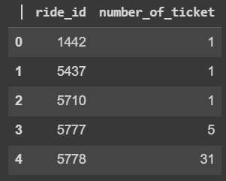
Data Wrangling
df.head(3)
#Checking number of unique ride ids
len(df['ride_id'].unique())
#Making target variable 'number of ticket' by grouping the dataframe on ride_id column
temp_df = df.groupby('ride_id')['seat_number'].count().reset_index()
temp_df.rename(columns = {'seat_number':'number_of_ticket'},inplace=True)
temp_df.head()
According to business problem, it requires us to predict the number of tickets we can sell on a particular route and particular date and time. Hence, a new column is created for number of tickets by grouping the data on ride_id

Slide 6
Data Wrangling
#Creating additonal features with travel_date and travel_time columns
#Creating a function to add the above features
def create_date_cols(df_temp):
df_temp['travel_month'] = df_temp['travel_date'].dt.month
df_temp['travel_year'] = df_temp['travel_date'].dt.year
df_temp['travel_day_of_month'] = df_temp['travel_date'].dt.day
df_temp['travel_day_of_year'] = df_temp['travel_date'].dt.dayofyear
df_temp['travel_day_of_week'] = df_temp['travel_date'].dt.dayofweek
df_temp['travel_hour'] = pd.to_datetime(df_temp['travel_time']).dt.hour
df_temp['quarter'] = df_temp['travel_date'].dt.quarter
df_temp['is_weekend'] = df_temp['travel_day_of_week'].apply(lambda x: 1 if x in [5,6] else 0)
return df_temp
#Applying function on our dataframe
df_copy = create_date_cols(df_copy)
ride_id | travel_date | travel_time | travel_from | car_type | max_capacity | number_of_ticket | date_time | travel_month | travel_year | travel_day_of_month | travel_day_of_year | travel_day_of_week | travel_hour | quarter | is_weekend
0 | 1442 | 2017-10-17 | 7:15 | Migori | Bus | 49 | 1 | 2017-10-17 07:15:00 | 10 | 2017 | 17 | 290 | 1 | 7 | 4 | 0
1 | 5437 | 2017-11-19 | 7:12 | Migori | Bus | 49 | 1 | 2017-11-19 07:12:00 | 11 | 2017 | 19 | 323 | 6 | 7 | 4 | 1
2 | 5710 | 2017-11-26 | 7:05 | Keroka | Bus | 49 | 1 | 2017-11-26 07:05:00 | 11 | 2017 | 26 | 330 | 6 | 7 | 4 | 1
3 | 5777 | 2017-11-27 | 7:10 | Homa Bay | Bus | 49 | 5 | 2017-11-27 07:10:00 | 11 | 2017 | 27 | 331 | 0 | 7 | 4 | 0
4 | 5778 | 2017-11-27 | 7:12 | Migori | Bus | 49 | 31 | 2017-11-27 07:12:00 | 11 | 2017 | 27 | 331 | 0 | 7 | 4 | 0

Slide 7
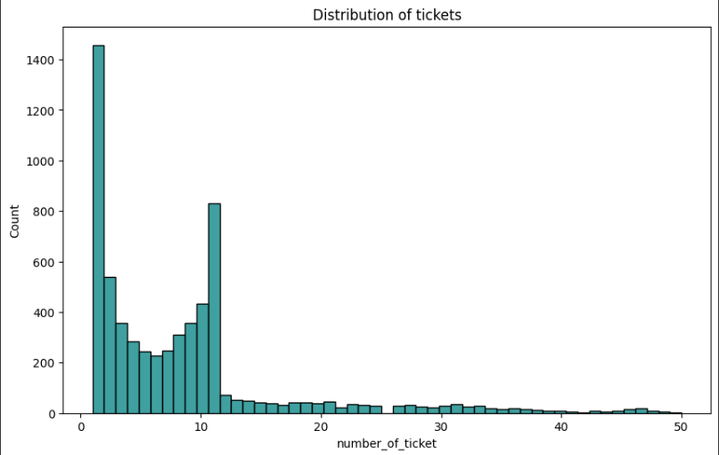
Data Vizualization
number of tickets bought per ride_id is between 1 and 12

Slide 8
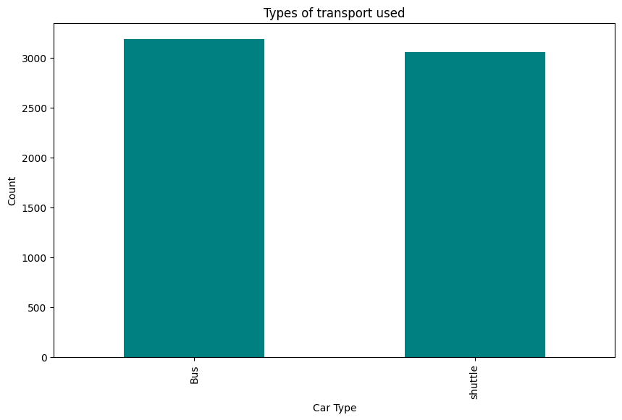
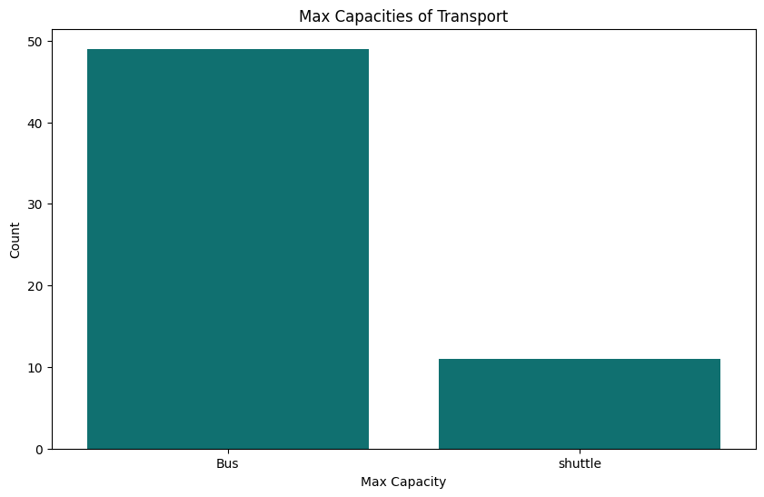
The number of Buses and shuttle are nearly equal in the data. Hence, both type of cars are used equally for traveling.

Slide 9
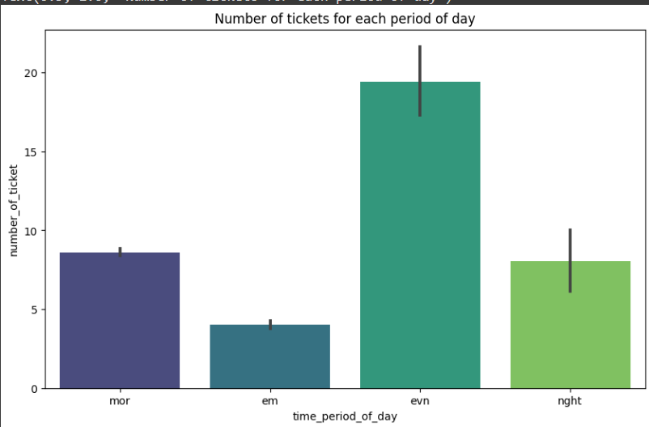
Hypothesis Testing
Hypothetical Statement - 1
1. State Your research hypothesis as a null hypothesis and alternate hypothesis.
Most number of tickets are sold in morning.
Null Hypothesis : Most number of tickets are sold in morning
Alternative Hypothesis : Most number of tickets are not sold in morning
From the graph we can see, max tickets are sold in evening, hence we can reject null hypothesis
Most number of tickets are sold in evening followed by morning hours.

Slide 10
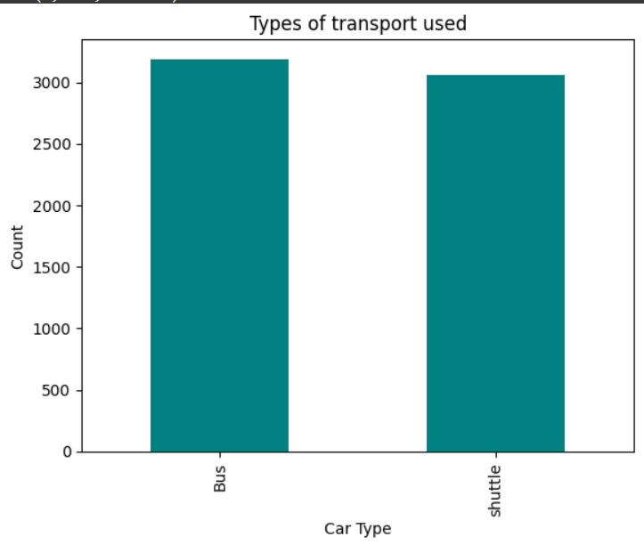
Hypothetical Statement - 2
Statement: The number of buses used in traveling is same as the number of shuttle used. Let Number of buses used be Nb, and Number of shuttle used be Ns
Null Hypothesis (H0) : Nb = Ns
Arlternative Hypothesis (Ha) : Nb != Ns
From above, Nb > Ns, hence we can reject Null Hypothesis.

Slide 11
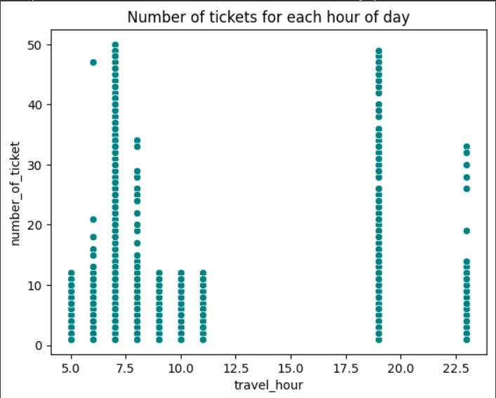
Hypothetical Statement - 3
There is no traveling done in afternoon. Let number of travellers at the afternoon period (12pm - 4pm) be Na.
Null Hypothesis (H0) : Na = 0 (No travellers in afternoon)
Alternative Hypothesis (Ha) : Na != 0
From the graph we can see that between 12pm and 4pm (Afternoon), there are no travellers, or number of tickets sold are 0.
Hence Na = 0, therefore we cannot reject Null Hypothesis

Slide 12
Feature Engineering, Data Pre-processing & Transformation
df_copy.time_period_of_day.value_counts()
3 value counts, we can see:
Some months have higher frequency of travel
Some days in year have very high frequency of travelers, while others have really low frequency. This is because of more traveling being done in some month than others.
Some days in a month have high frequeny of travel than others.
Some period in the day have high frequency of travel.

Slide 13
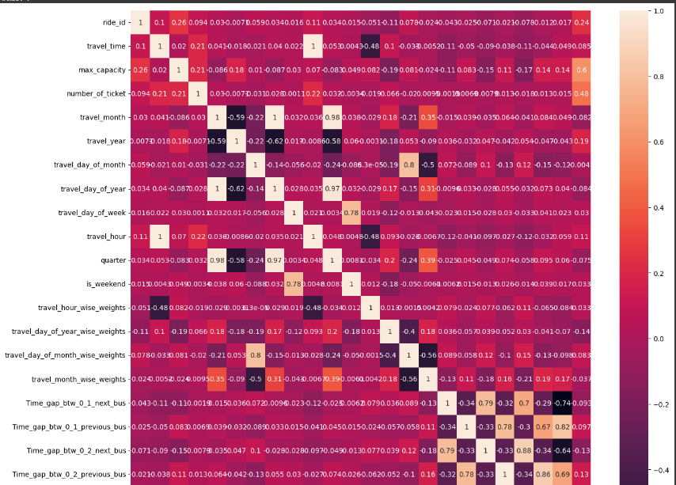
Multicollinearity
Many columns have high correlation with newly formed features. Hence columns like travel_month, travel_day_of_year, travel_day_of_month, etc. will be dropped because we have already created new weighted columns for these.

Slide 14
Data Splitting:
Data splitting is a fundamental technique in machine learning that involves dividing a dataset into training and testing sets. This practice serves several crucial purposes:
Model Evaluation: The training set is used to train the model, while the testing set is used to evaluate its performance on unseen data. This helps to prevent overfitting, where the model becomes too specialized to the training data and performs poorly on new data
Hyperparameter Tuning: Data splitting allows for hyperparameter tuning, where different values for model parameters are tried to find the optimal configuration. The training set is used to train the model with various hyperparameters, and the testing set is used to evaluate the performance of each configuration.

Slide 15
Models Used in Transportation Demand Prediction:
Various machine learning models have been employed for transportation demand prediction, each with its own strengths and weaknesses. Some of the commonly used models include:
Five models are implemented to predict the transport demand to Nairobi. These include:
Linear Models:
Linear Regression
Lasso Regression (L1)
Ridge Regression (L2)
Ensemble Models:
Random Forest
XGBoost
To improve model performance, k-fold cross validation and hyperparamter tuning is done using GridSearchCV.
Evaluation metrics such as MSE, RMSE, MAE, MAPE, R2 score and Adjusted R2 score is used to compare model performance

Slide 16
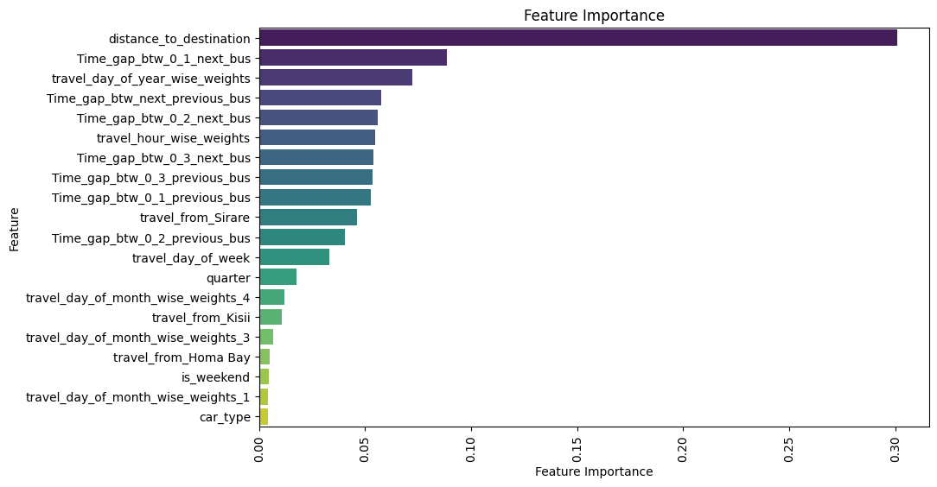
Hyper paramter tuned Random Forest model gave the best test accuracy, hence it it chosen as final prediction model.

Slide 17
Significant Improvements Due to Hyperparameter Tuning
Hyperparameter tuning is a critical step in machine learning that can significantly improve model performance. By carefully selecting the right hyperparameters, you can:
Prevent Overfitting:
Reduce complexity: Tuning hyperparameters can help simplify models, preventing them from memorizing the training data too closely and failing to generalize to new data.
Regularization: Techniques like L1 or L2 regularization, often controlled by hyperparameters, can penalize complex models, reducing the risk of overfitting.
2. Improve Model Accuracy:
Optimize performance: Finding the optimal hyperparameter values can lead to more accurate predictions on both training and testing data.
Enhance generalization: Well-tuned models are better able to generalize to unseen data, making them more reliable in real-world applications.

Slide 18
Insights Found:
Correlation between factors: Regression analysis can reveal significant correlations between transportation demand and various factors, such as population, income, land use, and economic conditions.
Trend identification: Regression models can identify trends and patterns in transportation demand over time, helping in forecasting future needs.
Impact assessment: By analyzing the coefficients of regression models, it is possible to assess the impact of different factors on transportation demand. For example, a high coefficient for population might indicate that population growth has a significant influence on traffic volume.
Sensitivity analysis: Regression models can be used to conduct sensitivity analysis, which involves examining how changes in input variables affect the predicted outcome. This can help in understanding the uncertainty associated with predictions.

Slide 19
Best Fit Evaluation Metrics:
R-squared (R²): Measures the proportion of variance in the dependent variable
(transportation demand) that is explained by the independent variables. A higher R² indicates a better fit.
Adjusted R-squared: Similar to R², but penalizes for the number of independent variables, making it more suitable for comparing models with different numbers of features.
Mean squared error (MSE): Measures the average squared difference between the predicted and actual values. A lower MSE indicates a better fit.

Slide 20
Model explainability:
Model explainability refers to the ability to understand how a machine learning model arrives at its predictions. It's essential for several reasons:
Trust and Confidence: When we understand how a model works, we can trust its predictions more. This is especially important in critical applications like healthcare, finance, and autonomous systems.
Debugging and Improvement: If we know why a model is making errors, we can fix them and improve its performance.
Regulatory Compliance: Many industries have regulations that require transparency in decision-making processes. Explainable models can help meet these requirements.
Fairness and Bias: Understanding a model's decision-making process can help identify and mitigate biases.

Slide 21
Think of regression as a tool that helps us predict one thing (like traffic volume) based on other things (like population, time of day, and weather). It's like trying to guess a person's height based on their shoe size.
Gather Data: We collect information about traffic volume, population, time of day, weather, and other factors.
Identify Relationships: We look for patterns between these factors. For example, we might find that traffic
volume increases during rush hour or on sunny days.
Build a Model: We create a mathematical equation that describes the relationship between these factors. This equation is called a regression model.
Make Predictions: We can use this model to predict future traffic volume based on the values of the other factors.

Slide 22
Conclusion
In this project, we have used different regression models to predict transport demand from various places
Using the data, we have created the target variable and several other features that contribute to our model performance.
We have used regression models including:
Linear Models : Linear Regression, Lasso (L1), Ridge (L2)
Non Linear Models: Random Forest, XGBoost.
We have also performed hyperparameter tuning to improve the performance of these models.
Out of all these models, the hyperparameter tuned Random Forest gives the best result with an accuracy of around 95%.

